Slide 1
COMP 2710 Software Construction Introduction to GDB
Dr. Xiao Qin
Auburn University http://www.eng.auburn.edu/~xqin
xqin@auburn.edu
Notes:
See /comp2710/samples/gdb_factorial.cpp
Error: init j = 1; i<“=“num
Enter the number: 5
The factorial of 5 = 120

Slide 2
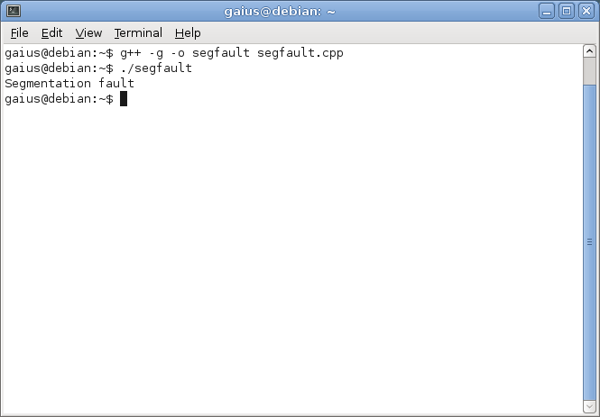

Slide 3
Demo 1: gdb_segfault.cpp
Please observe messages after we run:
$ ./gdb_segfault.cpp
$ gdb gdb_segfault.cpp
Notes:
/comp2710/samples/gdb_sample.cpp
/comp2710/samples/gdb_factorial.cpp
/comp2710/gdb_segfault.cpp
/comp2710/gdb_linked_list.cpp

Slide 4
Using GDB
Why use a debugger?
Usually you can figure out what’s going on just by using cout (print statements)
Debuggers allow for more fine-tuned control, and don’t force you to repeatedly re-compile your code every time you want to test something new

Slide 5
Using GDB
C++ programs with the g++ compiler can use GDB - the Gnu debugger
Function of a debugger:
set breakpoints
examine the contents of variables
dereference pointers to see what they’re pointing to
step into functions to see what’s happening

Slide 6
Using GDB
First step: we need to compile the program especially for debugging purposes
Add the flag –g when compiling
Your foo.cpp programs:
$ g++ -g -o foo-dbg foo.cpp
This will create a foo-dbg executable

Slide 7
Using GDB
Without the debugger, that executable will run perfectly normally
can do: ./foo-dbg
...and get perfectly respectable output.
You can also get into the details, using gdb:
$ gdb foo-dbg

Slide 8
Demo 2: run a program with GDB samples/gdb_sample.cpp
Please observe messages after we run:
$ gdb <executable_file>
What will happy if we forget to compile the source code?
What will happy if we forget to use the “-g” flag?
Notes:
/comp2710/samples/gdb_sample.cpp
/comp2710/samples/gdb_factorial.cpp
/comp2710/gdb_segfault.cpp
/comp2710/gdb_linked_list.cpp

Slide 9
Using GDB
gdb will open a prompt
(gdb) <enter commands here>
Keywords:
break
start, run
step, next
print
continue

Slide 10
Using GDB
Debuggers have the concept of a breakpoint
No matter what the code is doing, adding a breakpoint to your code will force the program to halt when it reaches that line
(gdb) break foo.cpp:9
...will add a breakpoint at line 9 of foo.cpp

Slide 11
Using GDB
Set up several breakpoints where you think that your code is probably having problems, or where you’d like to see the contents of the variables
You can add as many breakpoints as you like
on every line is overkill, but it won’t hurt you
Once the code hits the breakpoint, you have several options

Slide 12
Using GDB
Set up breakpoints before you start the program
When you’ve got your breakpoints, type start or run at the command line, and the code will start running until it hits a breakpoint
(gdb) start
You can also use start / run to restart a currently running program if you want to go back to the beginning

Slide 13
Using GDB
When the execution hits one of your predefined breakpoints, it’ll stop and you’ll have the option to give more commands to the debugger
Breakpoint 1, main () at foo.cpp:9
9 cout << “what is the number?" << endl;
(gdb)
The line that gets displayed is the line you chose to stop at – note that at this point, execution is right before this line, so the line hasn’t actually run yet

Slide 14
Demo 3: set up a breakpoint
Where do you want to set up a breakpoint?
$ gdb gdb_sample
(gdb) break <which line?>
What will happy if we set a breakpoint at a line without any code?
What will happy if we are at line 9, and set up a breakpoint at line 6?
Notes:
/comp2710/samples/gdb_sample.cpp

Slide 15
Set up a watchpoint
watch x == 3
Set a watchpoint, which pauses the program when a condition changes (when x == 3 changes). Watchpoints are great for certain inputs (myPtr != NULL) without having to break on every function call.
Notes:
/comp2710/samples/gdb_sample.cpp

Slide 16
Demo 4: set up a watchpoint
Command “continue”
$gdb gdb_factorial
b 12
s
//Step into factorial()
watch i == n-1
continue
Notes:
/comp2710/samples/gdb_sample.cpp

Slide 17
Using GDB
In order to make the line run, we can use the step and next commands
These are effectively equivalent, they move execution forward
BUT one crucial difference:
next moves forward in the same function (in this case the main function). after one line, it’ll stop again and wait for a command
step will stop after one line, but if there are any function calls on the line, it’ll “step” into them and stop there

Slide 18
Using GDB
Sometimes you’ll get a blank line as a prompt – that’s because you’re still running your program, and so anytime you have a cin >>, you’ll have to stop and enter input
15 cin >> value;
(gdb) next
1030 1415

Slide 19
Demo 5: use “next”
How to use “next” and trace to the line that has “cin”?
Notes:
/comp2710/samples/gdb_factorial.cpp
/comp2710/samples/gdb_sample.cpp

Slide 20
Using GDB
The step command moves into a function
17 object = testFunction(var1, var2);
(gdb) step
testFunction:: testFunction (this=0x804d008, var1=30, var3=18) at foo.cpp:12
12 testFunction();
There are a couple of things to look at here:
testFunction::testFunction – name of function
this=0x804d008 – that’s the memory address of the object we’ve just created
var1, var2 are the arguments to the function
foo.cpp:12 is where we’re stopped – line 12 of foo.cpp

Slide 21
Demo 6: use “step”
/comp2710/samples/gdb_factorial.cpp
Function: factorial() in main()
Step into the “factorial” function.
Notes:
/comp2710/samples/gdb_sample.cpp

Slide 22
Using GDB
Be a little careful when you use step
If you have a function that belongs to a standard library like string or vector, it’ll go ahead and step into it, but the output will be completely meaningless to you (Why?)
(you can sort of decipher it but it’s really not worth it, you can go ahead and trust that the problem is on your end)

Slide 23
Using GDB
If you don’t like what you’re seeing, and you know the problem isn’t here, you can type continue to get to the next breakpoint
(gdb) continue
Continuing.
Breakpoint 3, main () at foo.cpp:22
22 clientManager.add_client(client_info);
(gdb)

Slide 24
Using GDB
After running this line (with which keyword?), I’d like to see what ends up inside the client.name
We can use the print statement for that

Slide 25
Using GDB
Print tells you what’s currently in the variable
Sometimes this will look meaningless: memory addresses are values for pointers
(gdb) print clientManager.client_DB
$17 = std::vector of length 1, capacity 1 = {0x804d008}

Slide 26
Demo 7: use “print”, “display”, “undisplay”
Use “print” to see values of the two variables - i and j
How?
Notes:
/comp2710/samples/gdb_sample.cpp

Slide 27
Using GDB
Often a simple print statement will be totally sufficient
(gdb) print flightCtr
$18 = 0
We can use the dereference operator if we happen to have a pointer we’d like to examine
(gdb) print client_pointer
$19 = (Client *) 0x804d030
(gdb) print *client_pointer
$20 = {SSN = 123456, name = “sean”, … }

Slide 28
Using GDB
Arrays make it pretty easy to be examined, since they’re just a stretch of memory
Vectors are a little trickier – we have no direct access to the array underlying it. But the debugger has a way around it!
Notes:
(gdb) print *(ta.flights._M_impl._M_start)@ta.flights.size()
$24 = {0x804d008}
(gdb) print *(*(ta.flights._M_impl._M_start)@ta.flights.size())
$25 = (FlightTime *) 0x804d008
(gdb) print *(*(ta.flights._M_impl._M_start)@ta.flights.size())[0]
$26 = {beginTime = 630, endTime = 855, valid = true, invalid_num = 0}
It’s a little ugly, but it gets you where you need to be.

Slide 29
Using GDB
You’ll even be able to call some functions, but not all
Remember that if you have a pointer to 0, it’s a null pointer and shouldn’t be dereferenced
Fortunately gdb is smarter than our plain compiler and you won’t get a segfault
(gdb) print *client_pointer
Cannot access memory at address 0x0

Slide 30
Demo 8: use “set”
set x = 3
set x = y
Set x to a set value (3) or to another variable (y)
Notes:
/comp2710/samples/gdb_sample.cpp

Slide 31
Exercise: debug gdb_linked_list.cpp
Where to set break points?
Watch which variables?
Notes:
/comp2710/samples/gdb_sample.cpp

